Slide 1
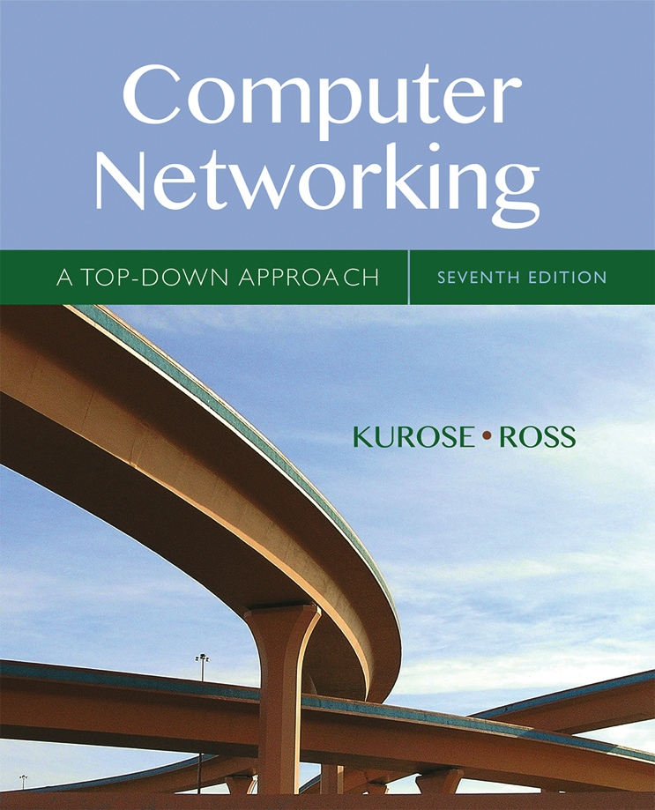

Orientation Quiz
Computer Networking: A Top Down Approach
If you use these slides (e.g., in a class) that you mention their source (after all, we’d like people to use our book!)
If you post any slides on a www site, that you note that they are adapted from (or perhaps identical to) our slides, and note our copyright of this material.
Thanks and enjoy! JFK/KWR
All material copyright 1996-2016
J.F Kurose and K.W. Ross, All Rights Reserved
7th edition
Jim Kurose, Keith Ross
Pearson/Addison Wesley
April 2016
Dr. Ezhil Kalaimannan
Introduction
1-1

Slide 2
Question 1
What are the five layers in the Internet Protocol Stack? What are the principal responsibilities of each layer?
The five layers in the Internet protocol stack are – from top to bottom – the application layer, the transport layer, the network layer, the link layer, and the physical layer.
1-<number>

Slide 3
Question 2
What is the difference between packet switching and circuit switching?
A circuit-switched network can guarantee a certain amount of end-to-end bandwidth for the duration of a call. Most packet-switched networks today (including the Internet) cannot make any end-to-end guarantees for bandwidth.
1-<number>

Slide 4
Question 3
Why do HTTP, FTP, SMTP, and POP3 run on top of TCP rather than on UDP?
The applications associated with those protocols require that all application data be received in the correct order and without gaps. TCP provides this service whereas UDP does not.
1-<number>

Slide 5
Question 4
What is the difference between routing and forwarding?
Forwarding is about moving a packet from a router’s input port to the appropriate output port. Routing is about determining the end-to-routes between sources and destinations.
1-<number>

Slide 6




Question 5
What is the 32-bit binary equivalent of the IP address 223.1.3.27?
11011111 00000001 00000011 00011100.
1-<number>

Slide 7
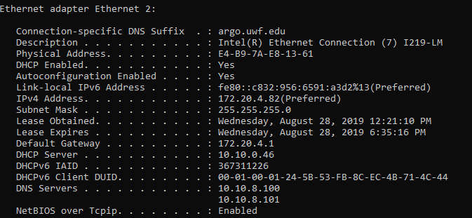
Question 6
How will you determine your IP address, network mask, default router, DHCP server IP address and IP address of its local DNS server. List these values.
1-<number>

Slide 8
Question 7
How big is the MAC address space? The IPv4 address space? The IPv6 address space?
2^48 (48-bit) MAC addresses; 2^32 (32-bit) IPv4 addresses; 2^128 (128-bit) IPv6 addresses.
1-<number>

Slide 9
Question 8
Describe the role of the beacon frames in Wireless Networks/Access Points?.
APs transmit beacon frames. An AP’s beacon frames will be transmitted over one of the 11 channels. The beacon frames permit nearby wireless stations to discover and identify the AP
1-<number>

